Slide 1
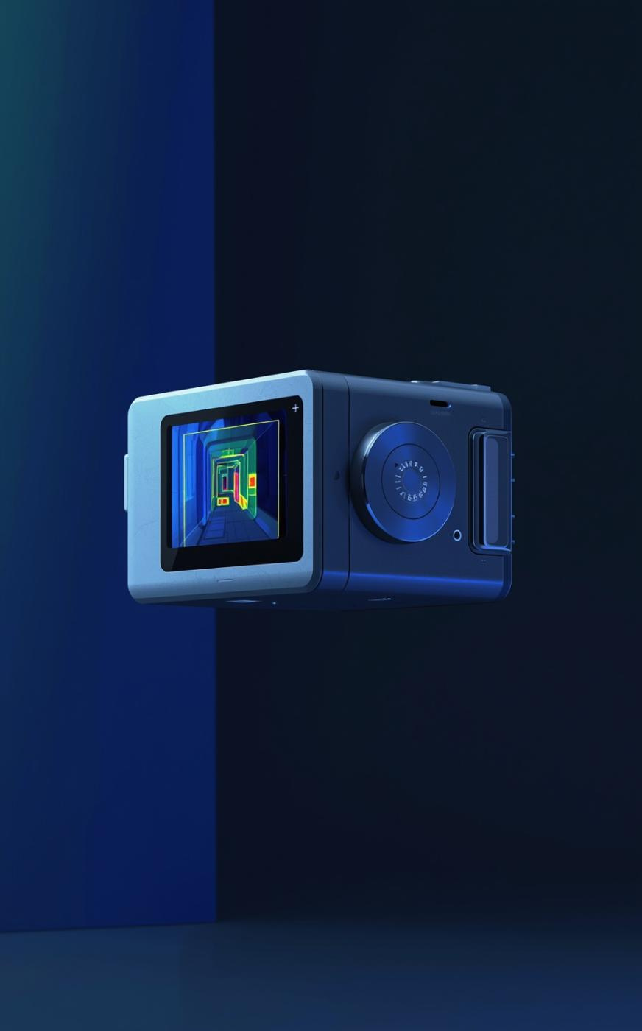

AL-Farabi University
Thermal Image Detection
Presented by [LAITH FAEEQ KHALEL]
Supervised by: Dr. [Al-Munther Mahmoud]
Course :Artificial Intelligence

Slide 2

Introduction to Thermal Imaging
• Thermal imaging captures infrared radiation instead of visible light. • It allows detection of heat signatures in low-light or dark environments. • It is widely used in surveillance, security, and rescue operations.

Slide 3
Challenges in Detection
Issues with Thermal Imaging
Detecting humans in thermal images poses significant challenges due to a lack of visible features, making it difficult to differentiate them from the background and impacting overall detection accuracy.

Slide 4
YOLOv8 Model Comparison
YOLOv8n Model
The YOLOv8n model is a smaller, faster option that provides quicker inference times but may sacrifice some accuracy in detection.
Evaluating Performance Variations Between Two YOLOv8 Models
YOLOv8s Model
The YOLOv8s model is larger and more accurate but has slower inference speeds, making it less suitable for real-time applications.
Performance Balance
Balancing speed and accuracy is crucial. The choice between YOLOv8n and YOLOv8s depends on specific application needs and resource availability.

Slide 5
Methodology Workflow
Load Model
Test Thresholds
Begin by loading the pre-trained YOLOv8 model necessary for detecting human presence in thermal images efficiently.
Experiment with various confidence thresholds, specifically 0.15, 0.25, and 0.50, to determine optimal detection performance.
Input Images
Record Detections
Input a series of thermal images into the model for analysis, ensuring proper formatting for optimal processing.
Systematically record total detection counts at each threshold level, facilitating comparison and analysis of detection accuracy.
Detect Persons
Analyze Results
Focus detection on the "person" class to enhance accuracy and reduce false positives during analysis of thermal data.
Analyze the results to identify trends in detection counts relative to the confidence thresholds, aiding in model tuning decisions.

Slide 6
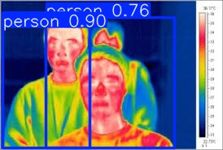
Confidence at
0.15
Highest detection count
• Highest detection count observed at confidence 0.15 • Lower threshold increases detection sensitivity

Slide 7
Final Model Selection
Choosing YOLOv8n for Efficiency
YOLOv8n was selected due to its balanced performance, lower computational cost, and faster processing speed.

Slide 8
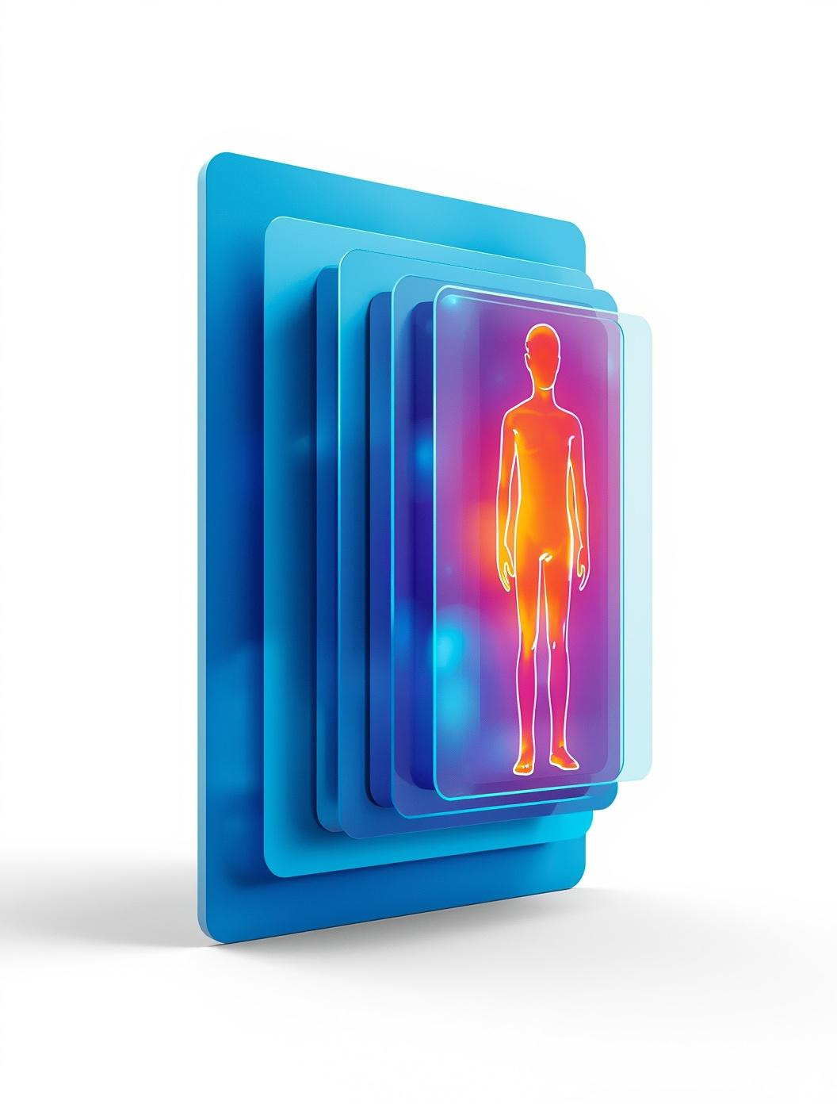
Conclusion
• Thermal imaging enables human detection in low-visibility conditions. • Detection performance varies with different confidence thresholds. • Lower thresholds increase detections but may introduce false positives. • YOLOv8n achieved a good balance between speed and accuracy
Thank you for your attention.

